Slide 1

Data Analytics Using Python
Dr. Ziping Liu
Chapter 1 Python Programming Language Review

Slide 2
https://he.kendallhunt.com/product/data-analytics-using-python
Chapter 1 Python Programming Language Review

Slide 3
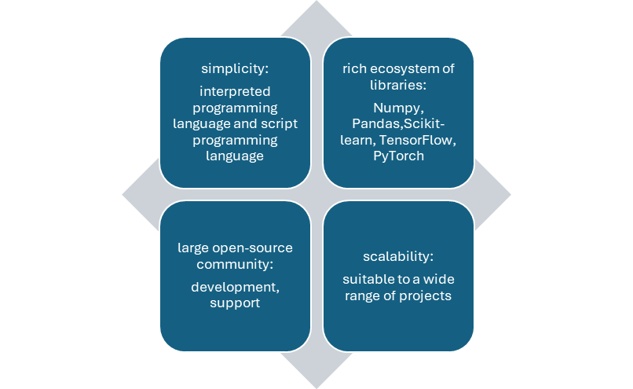
Python Advantages
Popular programming language data science and artificial intelligence
offers the advantages of simplicity, a rich ecosystem of libraries, a large open-source community, and scalability
Unlike compiled languages such as C++,Java
is an interpreted language, doesn't need to be translated into machine code before running. code executed line by line by an interpreter at runtime
has characteristics of a scripting language, being easy to learn and code, suitable for automating tasks and building prototypes.
Notes:
Compiled programming language’s compilation process: converts the high-level source code into machine code for the target architecture (e.g., x86, ARM)
Source code generation, preprocessing, intermediate code generation, machine code generation
The machine code is converted into object files (compiled pieces of the program). – assembly
The linker combines the object files and libraries into a single executable file. – linking
The result of the compilation process is an executable file (e.g., .exe on Windows, an ELF binary on Linux).
This file contains binary instructions that the CPU can execute directly.
The operating system loads the executable file into memory.
The CPU executes the binary instructions in the file.
Compiled programs run faster because the machine code is executed directly by the CPU
*********************************************************************************************
In an interpreted language, the source code is executed line by line or statement by statement by an interpreter, without needing prior compilation into machine code.
Platform Independence: As long as the interpreter is available, the same code can run on different systems without modification.
Performance: Interpretation is generally slower than execution of precompiled machine code.
*********************************************************************************************
A scripting language is a type of programming language designed to automate tasks, manipulate data, and control applications or systems without requiring the developer to explicitly compile the code before execution. Scripting languages are often used for tasks like:
Automating repetitive processes.
Extending the functionality of existing applications.
Writing small-scale programs quickly.
Manipulating files or data.
Examples include Python, JavaScript, Ruby, Perl, and shell scripting languages like Bash.

Slide 4
Getting Started with Python
Installation
  Install Python
  Install Anaconda
Integrated development environments (IDEs)
  PyCharm: A Python IDE for data science and web development.
  Visual Studio Code: A code editor developed by Microsoft for every major programming language.
  Spyder: A free and open-source scientific environment written in Python, for Python.
  Jupyter Notebook: A web application for creating and sharing computational documents.
Google Colab: web-based, no need to install Python and Jupyter Notebook locally

Slide 5
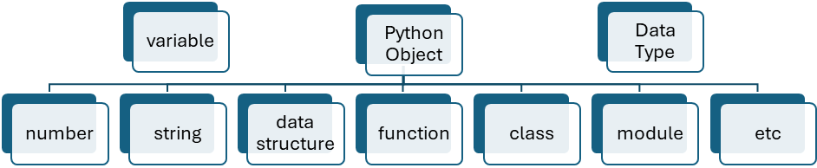
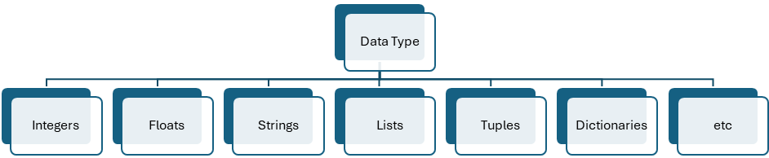
Python Basics
Variables and Data Types
  Variables are used to store data.
  Python variables are not explicitly typed.
  Python data types are associated with the objects that the variables reference
Notes:
since python doesn't have primitive data types, that means all values are stored on heap, is that right?
Gemini answer:
in Python, everything is an object, which means even simple integers or booleans carry the overhead of an object structure.¹ However, whether they are "stored on the heap" is a bit more nuanced depending on how you define the stack and how the Python interpreter (CPython) manages memory.
Here is a breakdown of how Python handles this.
1. Everything is an PyObject
In languages like C++ or Java, a float might just be 8 bytes of memory on the stack. In Python, a float is a structure on the heap. Even a simple integer like x = 42 is actually a complex C structure called a PyObject.
This structure includes:
Reference Count: Used for garbage collection.²
Type Pointer: Points to the "int" type object so Python knows how to handle it.³
Value: The actual numeric data.
2. The Role of the Stack vs. the Heap
While it’s true the objects themselves live on the heap, Python still uses a stack for execution.
The Python Stack: Stores references (pointers). When you write x = 1000, the integer object 1000 is created on the heap, but the name x on the stack simply holds the memory address of that heap object.
The Private Heap: This is where the actual data resides.⁴ Python’s memory manager handles this heap, and it's where the "heavy lifting" of object storage happens.⁵
3. The "Small Integer" Optimization
Because creating objects on the heap is expensive, CPython uses a trick for performance. It pre-allocates an array of integer objects for the range -5 to 256.
When you use an integer in this range, Python doesn't create a new object on the heap; it just points your variable to a pre-existing object in memory. This is why a = 256; b = 256; a is b returns True, but a = 257; b = 257; a is b usually returns False.
Summary Comparison
FeaturePrimitive Languages (C/Java)Python (CPython)Storage LocationOften on the StackAlways on the HeapMemory OverheadMinimal (e.g., 4 bytes for int)Large (e.g., 28 bytes for int)Access SpeedVery fastSlower (due to pointer indirection)BehaviorValue-basedObject-based
Is it "always" the heap?
Technically, yes. In the standard implementation of Python (CPython), the objects live in a private heap.⁶ However, some specialized compilers like PyPy use "Just-In-Time" (JIT) compilation and "escape analysis" to occasionally put values on the CPU stack or registers to make them run as fast as C.⁷
Would you like me to show you how to use the sys.getsizeof() function to see exactly how much memory these "non-primitive" objects are taking up?

Slide 6
Python Basics
Python numbers
  include integers and floats
  Integers: whole numbers without decimal points
  Floats: numbers with decimal points
  the running result is: int_var = 10, float_var = 10.00
int_var = 10
float_var = 9.99999
print(f"int_var = {int_var}, float_var = {float_var:.2f}")

Slide 7
Python Basics
Python Strings
  textual data enclosed in single, double, or triple quotes
  triple quotes allowing for multi-line strings or docstrings
  the running result is:
  one_quote_var = hello, world
  two_quote_var = hello, world
  three_quote_var = hello
  world
one_quote_var = 'hello, world'
two_quote_var = "hello, world"
three_quote_var = '''hello
world'''
print(f"one_quote_var = {one_quote_var}\ntwo_quote_var = {two_quote_var}\nthree_quote_var = {three_quote_var}")
Notes:
Single quotes are useful when the string contains double quotes: one_quote_var = ‘I said “hello, world”’
Double quotes are useful when the string contains single quotes: two_quote_var = "hello, it’s the world"

Slide 8
Python Basics
Python objects
  include collections of elements, such as Lists, Tuples, Dictionaries and Sets

Slide 9
Python Basics
Python Lists
  ordered collections of elements
  elements can be any data types
  can store heterogeneous collections of data
  can be created with brackets, and elements are separated by commas
  mutable
Exercise: use other approaches to create var_list, update one item in the list, remove one item from the list
var_list = [10, "hello", 9.99, True, [1, 2, 3], {"language": "Python"}]
print("before add a new item, var_list: ", var_list)
var_list.append(['new', 'item'])
print("after add a new item, var_list: ", var_list)
Notes:
var_list = list([10, "hello", 9.99, True, [1, 2, 3], {"language": "Python"}])
var_list.extend('three’) # will add five letters instead of one string, different from .append(‘three’), which is one string
print(var_list)
var_list2 = ['one', 'two', 'three']
v = var_list + var_list2
print(v)
v[5] = "updated"
print(v)
v.remove('e') #remove by value
print(v)
v.pop(4) #remove by index
print(v)
v[3:5] = [ ] #remove by slicing
print(v)
del v[3]
print(v)
del v[1:3]
print(v)
v = v * 2
print(v)

Slide 10
Python Basics
Python tuples
  ordered
  Immutable: cannot add new items to them or remove existing ones
  can store heterogeneous collections of data
  can be created with parentheses (), and elements are separated by commas
Exercise: use other approaches to create var_tuple, output one of the items
var_tuple = (10, "hello", 9.99, True, [1, 2, 3], {"language": "Python"})
print("var_tuple: ", var_tuple)
Notes:
var_tuple = tuple([10, "hello", 9.99, True, [1, 2, 3], {"language": "Python"}]) # use constructor
print("var_tuple[1]:", var_tuple[1])

Slide 11
Python Basics
Python Dictionaries
  key-value pairs
    keys are unique identifiers, immutable and hashable
    common data types for keys include strings, numbers, or tuples
    values can be any data type - numbers, strings, lists, dictionaries, or even custom objects
    values store the actual information associated with the key
  do not preserve the order in which elements were added
  mutable
  can be created with curly braces {}, and elements are separated by commas. Colons : separate the keys from their values
Exercise: use other approaches to create apple_stock, remove one key-value pair
Notes:
apple_stock = dict(symbol="AAPL", shares=100, price=150.25, total_value=15025.00) # use constructor
print(apple_stock)
del apple_stock["shares"]
print(apple_stock)
apple_stock = dict([("symbol", "AAPL"), ("shares", 100), ("price", 150.25), ("total_value", 15025.00)])
print(apple_stock)
removed_value = apple_stock.pop("shares")
print(apple_stock)
Hash functions are algorithms that take an input (or "message") and return a fixed-size alphanumeric string, which is typically a hash value. They are widely used in programming for data structures like hash tables, data security, and cryptography.
Choosing a Hash Function
Fast Lookups: Use Python's built-in hash() for dictionaries/sets.
Data Integrity: Use MD5, SHA-1, or SHA-256 for verifying file integrity.
Security: Use SHA-256 or SHA-3 for cryptographic purposes.
Performance: Use CityHash or MurmurHash for non-cryptographic applications.
Python Built-in hash() Function
Purpose: Generates a hash value for immutable objects like integers, strings, tuples, and more.
Use Case: Fast lookups in dictionaries and sets.
Output: An integer value.
Cryptographic Hash Functions
These are used for secure hashing and are implemented in Python using the hashlib module.
a. MD5 (Message-Digest Algorithm 5)
b. SHA Family (Secure Hash Algorithms)
CityHash / MurmurHash
CityHash:
Developed by Google for non-cryptographic purposes.
Focuses on speed for short strings.
MurmurHash:
Known for its good distribution and speed.
Commonly used in distributed systems and big data.

Slide 12
Python Basics
Python Dictionaries
# define a dictionary for apple stock
apple_stock = {"symbol": "AAPL", "shares": 100, "price": 150.25, "total_value": 15025.00}
# Accessing values by key
ticker = apple_stock["symbol"]
# Modifying a value
apple_stock["shares"] = 150
# Adding a new key-value pair
apple_stock["year"] = 2023
# get all keys as a list
print("all keys: ", list(apple_stock.keys()))
# get all values as a list
print("all values: ", list(apple_stock.values()))
# get all key-value pairs as tuples of list
print("apple stock: ", list(apple_stock.items()))
# If the key 'going up' exists in the dictionary appleStock, the get() method will return the associated value.
# However, if the key doesn't exist, the get() method will return the second argument, which is 'NaN' (Not a Number) in this case.
print(apple_stock.get('going up', 'NaN'))
# Unlike get(), setdefault() modifies the dictionary if the key doesn't exist.
# the key 'going down' is missing, setdefault() will add it to the dictionary with the value 'NaN'.
apple_stock.setdefault('going down', 'NaN')
print("apple stock: ", list(apple_stock.items()))

Slide 13
Python Basics
Python Sets
  unordered collections of unique elements
    Elements themselves immutable and hashable
  mutable, allow to add or remove elements
  can be created with curly braces {}, and elements are separated by commas
Exercise: use other approaches to create var_set, update one item in the list, add a new item, remove one item from the set
var_set = {10, 10, "hello", 9.99, True, (1, 2, 3)}
Print("var_set: ", var_set)
Notes:
var_set = set([10, 10, "hello", 9.99, True, (1, 2, 3)])
print("var_set:", var_set)
# Update: Remove 10 and add 100
var_set.discard(10) # Removes the item 10 if it exists
var_set.add(100) # Adds the item 100
print("Updated var_set:", var_set)
var_set.add("new item")
print("After adding new item:", var_set)
# Remove an item (e.g., "hello")
var_set.remove("hello")
print("After removing 'hello':", var_set)
# Or use discard to avoid KeyError if the item is not present
var_set.discard("nonexistent item") # Does nothing if item is not present

Slide 14
Python Basics
Python Indentation
  code blocks are defined by colon(:)
  typically using 4 spaces or tabs
  determines the scope of loops, conditionals, functions, classes, and other constructs

Slide 15
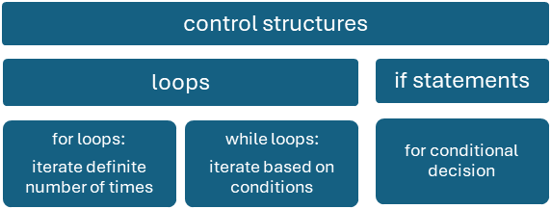
Python Basics
Control Structures

Slide 16
Python Basics
if statement: conditional execution, allowing code to run based on whether a specified condition is true or false
The usage for two-way conditions
if condition: # code to execute if the condition is True
else: # code to execute if the condition is False
The usage for multi-way conditions
if condition1: # code to execute if condition1 is True
elif condition2: # code to execute if condition1 is False and condition2 is True
elif condition3: # code to execute if condition1 and condition2 are False and condition3 is True
else: # code to execute if all conditions are False (optional)

Slide 17
Python Basics
if statement: conditional execution, allowing code to run based on whether a specified condition is true or false
The usage for nested if
if condition1: # code to execute if condition1 is True
if condition2: # code to execute if condition1 is True and condition2 is also True (nested if)
else: # code to execute if condition1 is True but condition2 is False
else: # code to execute if condition1 is False

Slide 18
Python Basics
If statement
investment = 1000
current_price = 1155
purchase_price = 1100
if purchase_price == 0:
roi = null
else:
roi = (current_price - purchase_price) / purchase_price * 100
earned = investment * roi / 100
if roi > 10:
print(f"Your investment has a strong return of {roi:.2f}% and you earn {earned: .2f}!")
elif roi > 0:
print(f"Your investment has a positive return of {roi:.2f}% and you earn {earned: .2f}")
elif roi == 0:
print(f"Your investment has broken even and you earn {earned: .2f}.")
else:
print(f"Your investment has a negative return of {abs(roi):.2f}% and you earn {earned: .2f}")
Notes:
roi is accessible throughout the rest of the program because it was defined at the module level (not inside a function or class), this is different from Java or C++

Slide 19
Python Basics
loop: repetitive tasks and/or collections of data
for/definite loop: iterate over a sequence (such as a list, tuple, string, or range):
for element in sequence:
# Code block to be executed
While/Indefinite loop: execute a block of code as long as a condition is true
while condition:
# Code block to be executed

Slide 20
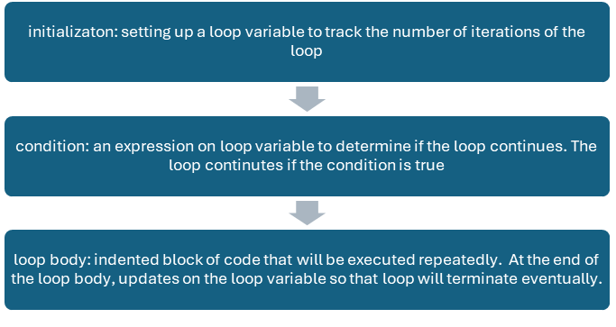
Python Basics
loop: repetitive tasks and/or collections of data

Slide 21
Python Basics
for statement
import random
stock_data = {
"AAPL": round(150.23 + random.random() * 10, 2),
"TSLA": round(900.00 + random.random() * 50, 2),
"GOOG": round(2800.00 - random.random() * 100, 2)
}
for symbol, price in stock_data.items():
print(f"Stock: {symbol}, Price: ${price}")

Slide 22
Python Basics
while statement
aapl_price = 159.23
guess = 180
guess_times = 1 # A counter is initialized to keep track of the number of guesses
while guess != aapl_price:
guess = float(input("Guess apple's stock price: ")) # Prompts the user to guess the stock price and converts the input to a float
if abs(guess - aapl_price) <= 10 and guess_times < 3: # abs(): find absolute value of an expression
print("Congratulations, you guessed the price!")
break # exits the loop
elif abs(guess - aapl_price) > 10 and guess_times < 3:
print("Try again!")
else:
print("Run out of guessing times!")
break # exits the loop
guess_times +=1 # increments the guess counter after each guess

Slide 23
Python Basics
Functions: reusable blocks of code designed to perform specific tasks
function definition:
def function_name(parameters): # function header
"""Function docstring (optional)"""
# Function body (indented code block)
return output_value (optional)

Slide 24
Python Basics
function
import yfinance as yf # import yfinance library for stock data
def get_stock_data(symbol): # define function header
try:
stock_data = yf.download(symbol, period="1wk", interval="1d") # download 1-week daily data from Yahoo Finance
except:
print(f"Error: Could not retrieve data for symbol {symbol}.")
return None
current_price = stock_data["Close"].iloc[-1] # get latest closing price
current_volume = stock_data["Volume"].iloc[-1] # get latest volume
return {"Stock ticker": symbol, "Current Price": current_price, "Current Volume": current_volume} # return a dictionary
# passing google, apple and tesla's stock tickers
stock_symbol = ["GOOG", "AAPL", "TSLA"]
for ticker in stock_symbol:
data = get_stock_data(ticker) # data is a dictionary returned from the get_stock_data() function
if data:
for key, value in data.items():
print(f"{key}: {value}")
Notes:
// java program
public class HelloWorld {
public static void main(String[ ] args) {
// Print a greeting message
System.out.println("Hello, World!");
}
}
// C++ program
int main( ) {
// Print a greeting message
std::cout << "Hello, World!" << std::endl;
return 0;
}
// C program
int main( ) {
// Print a greeting message
printf("Hello, World!“);
return 0;
}
# print(current_price) # can't access local variable current_price, out of scope, if we add the statement outside of the function def

Slide 25
More on Python
try-except block: prevent potential program crashes
try-except block definition:
try:# Code that might raise an exception
except [ExceptionType]:
# Code that continues to run in case of the exception
[except (ExceptionType1, ExceptionType2) as e:
# Code that continues to run in case one of the exceptions]
…
[else: # Code that continues to run if no exception occurs
finally: # Code that always runs, regardless of exceptions]

Slide 26
More on Python
Indexing and Slicing
  access elements within sequences
  indexing: extract a single element using its position
    index starting from 0 (zero-based indexing)
    use square brackets[] with the index within them to access an element
    allows negative indexing to access elements from the end of the sequence: -1 refers to the last element, -2 to the second-last, and so on
  Slicing: extract a sub-sequence
    use square brackets [] with a start index, an end index, and an optional step (separated by colons): [start:end:step]
    The end index in slicing is exclusive
    can omit the start or end index in slicing to use the default values. If the step is omitted, the default step is 1

Slide 27
More on Python
indexing and slicing
var_list = [10, "hello", 9.99, True, [1, 2, 3], {"language": "Python"}]
# access first item
print("first item: ", var_list[0])
# access last item
print("last item: ", var_list[-1])
# access the second to the fourth items
print("the second to the fourth items: ", var_list[1: 4])
# use slice assignment to append a list at back or at front, or remove part of a list
var_list[len(var_list):]=['X', 'Y', 'Z']
print("use slice to append at back: ", var_list)
var_list[:0] = ['A', 'B', 'C']
print("use slice to append at front: ", var_list)
var_list[9:-1]=[]
print("use slice to remove: ", var_list)
# use negative step for reversing
print("after reversing: ", var_list[::-1])

Slide 28
More on Python
zip( ) built-in function
  creates an iterator that aggregates elements from multiple sequences, and pair them together
tickers = ["GOOG", "TSLA"]
prices = [172, 175]
# Combine tickers and prices into a list of tuples
stocks = list(zip(tickers, prices)) # zip returns an iterator, convert to list
print(stocks)

Slide 29
More on Python
* and ** as function arguments/parameters
  * unpacking arguments from iterables (like lists, tuples) into individual arguments for the function
# Unpacking Arguments when used for arguments
def do_unpack(ticker, price):
print(f"Storck Ticker: {ticker}, Price: {price}")
# Call do_unpack with each ticker-price tuple
for stock in stocks:
do_unpack(*stock) # Unpack the tuple into ticker and price arguments

Slide 30
More on Python
* and ** as function arguments/parameters
  * catching variable number of arguments: capture any number of arguments passed to the function as a tuple
# Catching variable number of arguments when used for parameters
def sum_all(*numbers):
total = 0
for num in numbers:
total += num
return total
result = sum_all(1, 2, 3, 4, 5)
print(result)

Slide 31
More on Python
** syntax
  can be used both in function parameters to accept keyword arguments and in keyword argument unpacking to pass arguments
def unpack_dictionary(**kwargs):
for key, value in kwargs.items():
print(f"{key}: {value}")
# Creating a dictionary
stock_dict = dict(zip(tickers, prices))
# Passing the dictionary to the function using **
# **stock_dict unpacks the key-value pairs of the dictionary, and each pair becomes a separate keyword argument to the function
unpack_dictionary(**stock_dict)

Slide 32
More on Python
Python Comprehensions and Generator Expression
  comprehension: build a sequence data structure, such as a list, set, or dictionary, using existing sequences
  for tuple comprehension: use the tuple() constructor in combination with a generator expression
  generator:
    a special type of iterator that supports iteration over a sequence of elements
    doesn’t store the entire sequence in memory but generates one element at a time on demand
    memory-efficient and capable of handling even infinite sequences

Slide 33
More on Python
Python Comprehensions and Generator Expression
Syntax to create a list comprehension: [expression for val in collection if condition]
Syntax to create a set comprehension: {expression for val in collection if condition}
Syntax to create a dictionary comprehension: {key_expression : value_expression for val in collection if condition}
Syntax to create a generator expression: (expression for val in collection if condition)

Slide 34
More on Python
Python Comprehensions and Generator Expression
var_list = ['A', 'B', 'C', 10, 'hello', 'hello', 'hello', 9.99, True, [1, 2, 3], {'language': 'Python'}, 'X', 'Y', 'Z']
# build a list comprehension from an existing list's string elements
comp_list = [var for var in var_list if isinstance(var, str)]
print(comp_list)
# build a set comprehension from an existing list's string elements
comp_set = {var for var in var_list if isinstance(var, str)}
print(comp_set)
# build a dictionary comprehension from two existing lists
stock_symbol = ["GOOG", "AAPL", "TSLA"]
stock_price = [172, 190, 175]
stocks_share = {symbol:price for symbol, price in zip(stock_symbol, stock_price)}
print(stocks_share)
# build a generator comprehension from an existing list's string elements
comp_generator = (var for var in var_list if isinstance(var, str))
print(comp_generator)
for var in comp_generator:
print(var, end = ' ')
print()
# build a tuple using generator comprehension
comp_to_tuple = tuple(var for var in var_list if isinstance(var, str))
print(comp_to_tuple)

Slide 35
More on Python
Lambda Expressions
  functions: have a header containing the function name and a list of parameters
  lambda expressions are simple, anonymous functions that can be defined and used inline
Syntax for lambda expressions:
lambda parameter1, parameter2, . . .: expression
# two lambda expressions are used to do calculations between feet and meter conversion
width = {'Feet to Meter': lambda feet: 0.305 * feet,
'Meter to Feet': lambda meet: 3.281 * meter}
print(width['Feet to Meter'](3.9))

